Slide 1
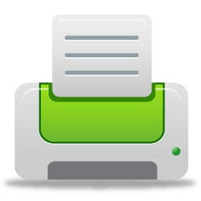
Print Reduction and Paper Conservation
Maryland Department of General Services
2015

Slide 2
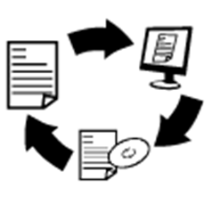
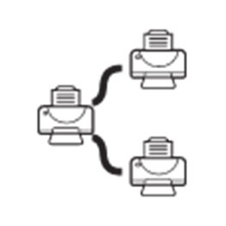
Outline
Printing Costs
Printing Best Practices
Print Reduction
Paper Conservation
Waste Reduction
Online Resources

Slide 3
Printing Costs
In FY 2014, DGS spent $8,377 on printer paper. Only 19% (about $1,600) had recycled content.
In CY 2014, DGS spent approximately $175,000.00 printing to multi-function devices.
In FY 2014, DGS spent $15,000 on toner for convenience printers.

Slide 4
Print Reduction
Use Non-Paper Methods to Work, Store and Communicate
Only Print When Necessary
Researchers at Xerox found that about half of the documents printed in a typical office are discarded within 24 hours.
Paper production is highly energy-intensive, using over 12% of all energy in the industrial sector, and the paper and pulp industry is the fourth largest emitter of greenhouse gases in the manufacturing sector.

Slide 5
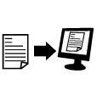
Print Reduction
Ask yourself:
If I need to file or reference later, can I save an electronic (rather than paper) copy?
If I need to share, can I send an electronic (rather than paper) copy?
If I need to print, do I need the entire document (or email chain) – or will selected page(s) suffice?

Slide 6
Print Reduction
Saving an Electronic Copy
From the File → Print menu, you can digitally print files as a PDF.
Under the Printer drop down menu, select CutePDF Writer, Adobe PDF or select Print to File. A new window will open where you can name your file and choose where to save it.

Slide 7
Paper Conservation
Use Print Preview (to ensure documents and spreadsheets print correctly)
Always Print Double-Sided
Only Print What You Need (pages, copies)
Use Secure Print (for confidentiality and to avoid ‘losing’ your documents)
DGS purchases approximately 1,000,000 sheets of 8.5 x 11 white copy paper each year (which costs approximately $7,000.00) and spends approximately $175,000.00 each year printing to multi-function devices.

Slide 8
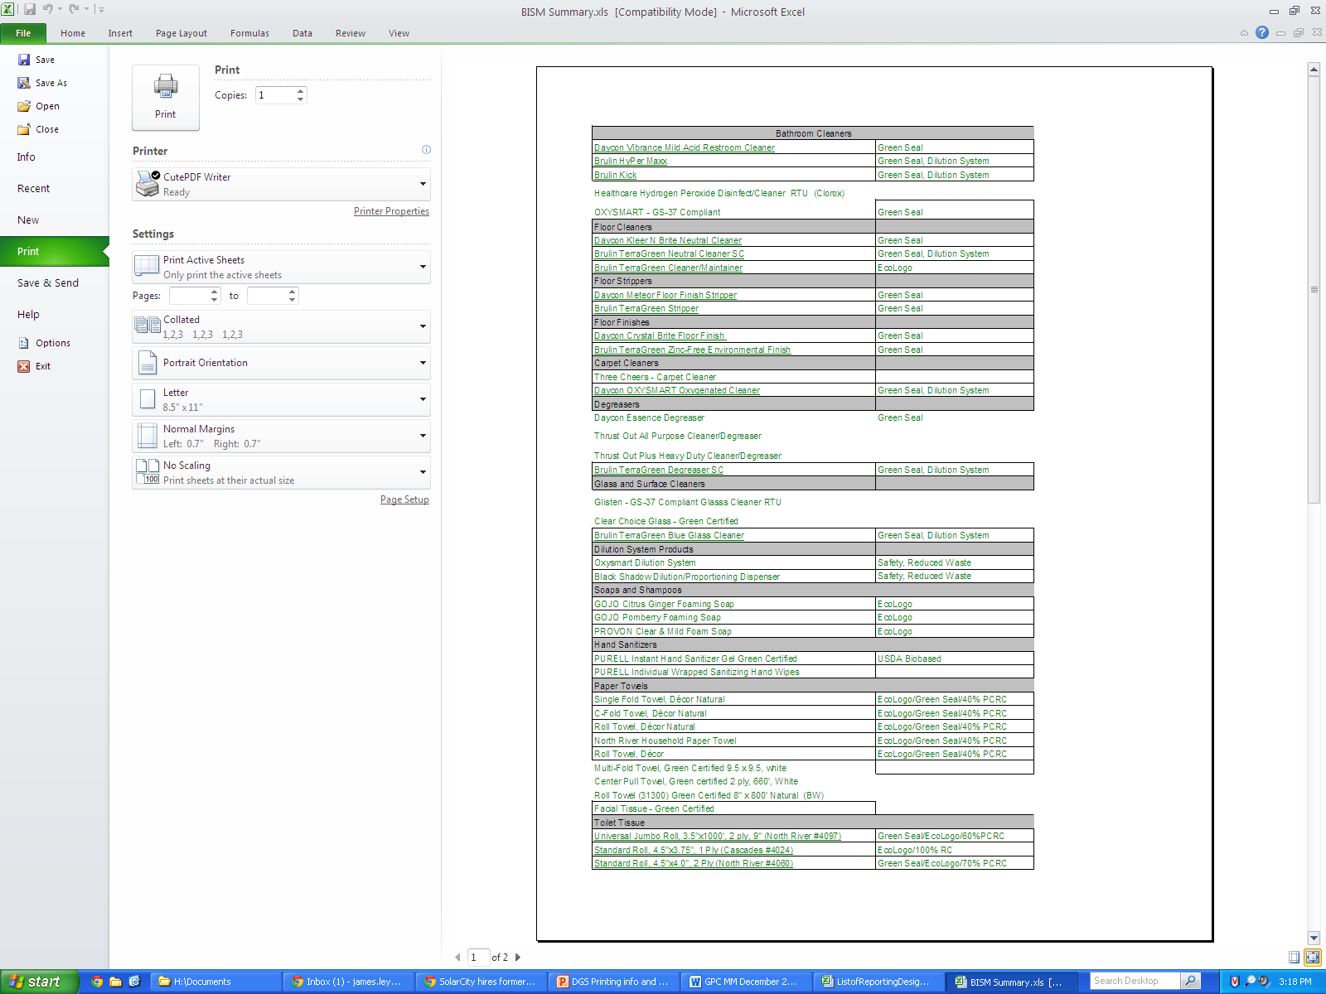
Paper Conservation
Using Print Preview
Helps eliminates formatting errors prior to printing.
The latest versions of Microsoft Office automatically display pages as they will be printed.

Slide 9
Paper Conservation
Printing Double-Sided
From the File → Print menu, you can print double-sided (pages flipped on long or short edge).
Under Settings, select Print on Both Sides to choose your preference.

Slide 10
Paper Conservation
Using Secure Print
Improves security and confidentiality of printed documents
Eliminates the “loss” of documents that aren’t retrieved immediately
Eliminates the need for “convenience” printers (often installed to ensure confidentiality)
Refer to the DGS “Printing Best Practices” guide, which includes instructions and can be found on the DGS website.
Notes:
Reduce printing waste
As people print on shared printers, they often have to get up and walk to the printer to pick up their documents. But often, they get interrupted or want to pick up the document later when they have finished something they are currently busy with. What happens, though, is that they often forget it, and when they remember and rush to the printer, the document has been recycled and they have to print again.
Improved printing security
Confidential documents can fall into the wrong hands and important information can leak if the wrong person sees the printed documents. Secure printing makes it possible for the organization to make printouts confidential even on shared printers, thereby avoiding information to leak to unauthorized personnel.
Remove local printers
Local printers are often kept for security purposes (see point 2). But with secure printing implemented, security is kept even when printing on shared printers, so all those expensive local printers can be removed.
Improved end user productivity
Without secure printing, each time a document is printed the employee has to rush to the printer and pick up the documents before someone else does. And even worse, if the printers are out of order time is wasted and frustration spreads in the organization. But with secure printing, the employee can print as many documents as they wish, have it waiting for them in the queue, and pick it all up in bulk later (for example when coming back from lunch). And if a printer is not functioning properly, he or she can simply walk up to another printer and pick the documents up instead of being forced to print it all again.

Slide 11
Waste Reduction
Conserve Resources By Recycling
Purchase Recycled Paper and Office Supplies
Manufacturing recycled paper requires less energy than making paper from virgin wood pulp.
However, paper made up 16% of landfill solid waste in 2009.
Recycling one ton of paper saves 682.5 gallons of oil, 7,000 gallons of water, 3.3 cubic yards of landfill space.
Notes:
http://www.forestethics.org/paper-the-facts
http://www.id2.ca/downloads/eco-design-paper-facts.pdf

Slide 12
Waste Conservation
Using “Econo-Mode” or “Draft Quality”
Reduces toner use and the bleaching required during recycling.
From the File → Print menu,
From the Page Setup dialogue box Sheet tab, select the print option Draft Quality, Econo-Mode or Toner Save.

Slide 13
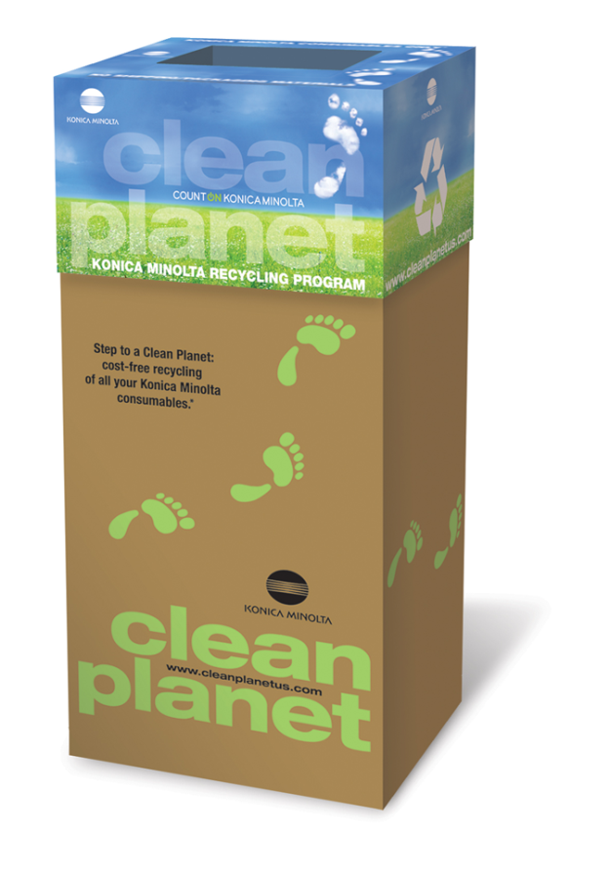
Waste Conservation
Toner Recycling
Any empty ink and toner cartridges can be recycled using the KONICA MINOLTA clean planet boxes.

Slide 14
Online Resources
Printing information, guidelines and secure print instructions can be found on the “Green Operations” section of the DGS website.

Slide 15
For questions or assistance, please contact:
James Ley 410.767.4335 james.ley@maryland.gov

